Slide 1
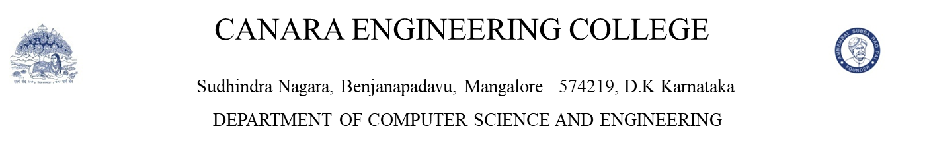
AI BASED MOCK INTERVIEW SIMULATOR
Team ID:CEC/CSE/2026-27/P-32
Under the guidance of
Ms. Verdine Saviola Noronha
Assistant Professor, CSE
Karishma M P
N G Shraddha Kumari
Neha N
Prakruti C Nayak

Slide 2
TABLE OF CONTENTS
Introduction
Literature Survey
Research Gap
Problem Statement
Requirements
Scope
Application areas
Expected results
Conclusion

Slide 3
INTRODUCTION
Simulates real interview rounds with MCQs and behavioral (voice-based) questions.
Provides a time-bound, exam-style environment to improve accuracy and confidence.
Uses AI-based speech recognition and automated scoring for behavioral responses.
Helps students practice, evaluate performance, and identify areas for improvement.

Slide 4
LITERATURE SURVEY

Slide 5
 | Authors | Title | Methodology | Key results | Scope for improvement
1 | Sangeetha V. et al. (2024) | Automatic Scoring of Autobiographical Interview Using NLP | Transformer-based NLP + semantic density scoring | Achieved high correlation (0.78) with human raters | Struggles with vague/short responses; lacks multimodal cues
2 | Annish Brislin M.R. et al. (2025) | AI-Enabled Automated Interview Evaluation System | Web system + semantic analysis + automated scoring | Reduced manual evaluation workload significantly | Backend scalability issues; no emotion/body-language analysis
3 | Chen & Li (2025) | Smart Interview Simulator with Real-Time Speech & Emotion Analysis | Speech recognition + facial emotion detection | Increased user confidence; real-time analytical feedback | Emotion accuracy drops in noisy environments

Slide 6
4 | Jones et al. (2022) | Automated Scoring of Speaking and Writing – A Review | Hybrid acoustic–linguistic scoring models | 55% improvement in reliability across languages | Bias issues, low explainability, fairness concerns
5 | Cheng et al. (2022) | Automatic Scoring of Spoken Language Using Acoustic & Linguistic Features | MFCC features + syntactic complexity metrics | 62% improvement in pronunciation scoring | Weak for spontaneous/unstructured answers
6 | Isbell et al. (2023) | ASR Reliability for Automated Scoring | ASR transcript evaluation under varied accents/noise | Improved scoring efficiency by 67% | 25% transcription error for accented speech

Slide 7
7 | Hacking & Gupta (2022) | Interview-Domain ASR Model Training | Domain-specific ASR acoustic training | 30% reduction in word error rate | Requires large annotated datasets; not scalable
8 | Park et al. (2024) | ASR Bias in Personnel Selection | Bias analysis + dialect testing | Identified up to 28% higher error for minority speakers | Requires fairness metrics + better mitigation

Slide 8
9 | Saha (2023) | Real-Time Voice-Based Automated Interview Agent | AI voice agent + follow-up question generation | 52% improvement in interview efficiency | Behavioral scoring still shallow
10 | Van Genugten (2024) | NLP-Based Scoring of Autobiographical Interviews | Transformer NLP + semantic coherence scoring | 85% reduction in scoring time; 0.78 correlation | Overfits domain; no emotion/prosody analysis

Slide 9
RESEARCH GAP
Lack of integrated multi-round simulation
No real-time behavioral scoring
Absence of dynamic question generation
Limited performance analytics

Slide 10
PROBLEM STATEMENT
Students lack a realistic platform to practice interviews in a time-bound environment. Existing platforms provide basic question banks but fail to simulate time pressure, dynamic questioning, and behavioral rounds with meaningful feedback. There is a need for an integrated system that is capable of all these features.

Slide 11
OBJECTIVES
To Design a unified platform that simulates both technical MCQ and behavioral interview rounds.
To Integrate AI-based speech evaluation to assess clarity, structure, and delivery of responses.
To Provide real-time scoring, analytics, and session history for continuous performance tracking.

Slide 12
REQUIREMENTS
Hardware:
Minimum 4GB RAM
Internet connectivity (WI-FI/4G/5G)
Server storage for database
Standard built-in or external microphone

Slide 13
REQUIREMENTS
Software:
Development tools: VSCode, live server extension, web browser, CSV/JSON files
Frontend: HTML, CSS, Bootstrap
Core backend: Javascript
Database: Built- in local storage
Key packages: Web speech API, MediaDevices API, FileReader API, LocalStorage API

Slide 14
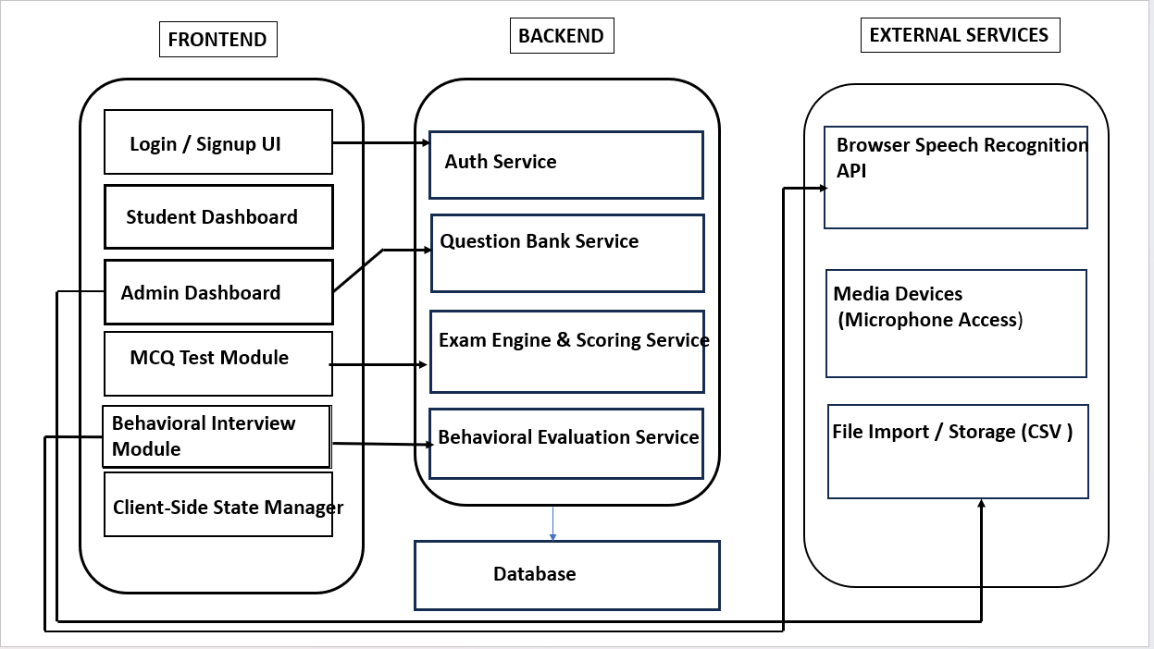
ARCHITECTURE DIAGRAM

Slide 15
SCOPE
User Registration and Authentication
Subject Selection for MCQ Tests
Randomized Technical Question Generation
Timer-Based MCQ Examination
Behavioral Interview Speech Recording
AI-Driven Transcript Evaluation
Result Display with Performance Analytics
Admin Panel for CSV/JSON Question Upload

Slide 16
APPLICATION AREAS
Interview preparation for college students and job seekers
Training and assessment tool for placement cells
Automated mock interviews for skill development platforms
Self-assessment tool for improving communication and confidence

Slide 17
RESULTS
Users can practice complete multi-round interviews in one system, improving overall preparedness.
Users receive automated, meaningful feedback that enhances communication and behavioral skills.
Users gain insights into strengths and weaknesses, enabling targeted improvement over time.

Slide 18
CONCLUSION
The system provides a unified platform for practicing both technical MCQs and
behavioral interview rounds.
AI-based speech evaluation improves users’ communication and confidence through automated feedback.
Real-time scoring and analytics help users identify strengths and areas for
improvement.
Overall, the simulator enhances interview readiness by offering a realistic,
structured, and interactive practice environment.

Slide 19
REFERENCES
1. S. V. Sangeetha, M. Balakumaran, P. Kalaiselvi, S. Harini, A. S. Naimesha, and M. Sribalaji, “Automatic Scoring of Autobiographical Interview Using NLP,” International Conference on Computational Linguistics and Speech Processing, 2024.
2. A. Brislin M. R., A. Mayan J., R. A. Canessane, and A. Hamlin M. R., “AI-Enabled Automated Interview Evaluation System,” International Conference on Communication and Electronics Systems (ICCES), 2025.
3. Y. Chen and L. Li, “AI-Driven Smart Interview Simulator with Real-Time Emotion and Speech Analysis,” IEEE International Conference on Intelligent Computing, 2025.
4. K. Jones, P. Wiliams, and R. Walker, “Automated Scoring of Speaking and Writing – A Review,” Journal of Language Assessment Technologies, 2022.
5. L. Cheng and Q. Zhao, “Automatic Scoring of Spoken Language Using Acoustic and Linguistic Features,” IEEE Transactions on Audio, Speech, and Language Processing, 2022.
6. J. Isbell, T. Carter, and M. Singh, “ASR Reliability for Automated Scoring Under Accented and Noisy Conditions,” IEEE Speech Processing Symposium, 2023.
7. R. Hacking and A. Gupta, “Domain-Adapted ASR Models for Interview Speech Recognition,” International Conference on Speech and Signal Processing (ICSSP), 2022.
8. S. Park, L. Martinez, and G. Young, “ASR Bias in Personnel Selection: A Fairness and Reliability Study,” ACM Conference on Artificial Intelligence and Ethics, 2024.
9. A. Saha, “Real-Time Voice-Based Automated Interview Agent,” International Conference on Human-Computer Interaction (HCI), 2023.
10. T. Van Genugten, “Transformer-Based Scoring of Autobiographical Interviews,” European Conference on Natural Language Processing (ECNLP), 2024.

Slide 20
THANK YOU

